Slide 1
Evolving geographic pattern of Cenozoic magmatism in the North American Cordillera:
The temporal and spatial association of magmatism and metamorphic core complexes
Richard Lee Armstrong and Peter Ward
1991
Presentation by James McNeil

Slide 2
Introduction
Map shows tectonic belts and geographic base map
Presentation of the distribution of magmatic activity over the entire Cordilleran region
First of its kind up to this point (1991)
11,500 age determinations spanning 230 Ma in the Cordillera
50% used in 55-0 Ma time interval figures

Slide 3
Before 55 Ma
“Major turning point in Cordilleran tectonics occurred about 55 Ma ago.”
Magmatism accelerates rapidly at 60 Ma
Shift from crustal shorteneing to crustal extension and strike slip faulting north of 42°
Laramide uplifts in Wyoming and Montana and magmatism in Arizona ceased by 55 Ma
Consistent Laramide magmatic locus in central Colorado
Uplifts to the south in Colorado-New Mexico continue until 40 Ma

Slide 4
Time Interval 40-55 Ma
Distribution of magmatism from 55 to 40 Ma
Magmatic episode “Kamloops-Challis-Absaroka” occurred 60-45 Ma ago in Canada and northern Washington
Southward transgression of intermediate-composition magmatism
3 enigmatic magmatic belts along the western margin

Slide 5
Time Interval 25-40 Ma
Weak magmatic maximum ‘ignimbrite flareup’ in Oligocene time (35-30 Ma)
Southward transgression of east-west belt of magmatism in Nevada and Utah
Colorado Plateau laccoliths emplaced 25-22 Ma
SW Montana magmatism

Slide 6
Time Interval 10-25 Ma
Voluminous eruption of basalt between 17 and 14 Ma in the Columbian Plateau
Lull in activity at 17 Ma in B&R and Rio Grande Rift
Northward merging of magmatic fields → meta core complexes
Change to bi-modal volcanism at 15-12 Ma

Slide 7
Time Interval 0-10 Ma
Pliocene lull in activity followed by accelerated magmatism during the last 2-3 Ma
Eastern development and migration of Snake River Plain and Yellowstone tied to eastern margin of B&R
Bi-modal volcanism in SW California

Slide 8
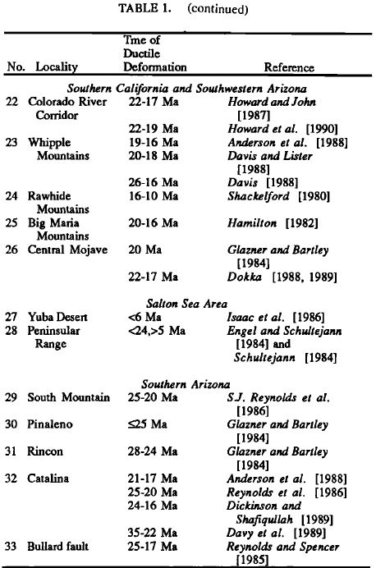
Timing of Ductile Deformation in Core Complexes
List of core complexes or closely related areas of ductile deformation related to the uplift and rapid cooling of metamorphic rocks
Southward younging of core complexes and associated with regional magmatism
Core complexes of the Cordillera form only within the largest magmatic belts and fields

Slide 9
40-55 Ma
Next figures show locations and times of ductile deformation
Central British Columbia to central Idaho metamorphic core complexes of middle Eocene age are related with the Eocene magmatic episode
Width of deformation is defined by the width of the magmatic arc

Slide 10
25-40 Ma
Ductile extension occurs within two major magmatic fields
Southern Idaho, eastern Nevada, northwestern Utah formed synchronously with the ignimbrite flareup in Nevada
Southern Arizona complexes may be as old as (25-40 Ma) but are likely younger

Slide 11
10-25 Ma
Ductile and brittle extension is focused in the Colorado River Corridor
Main period of Basin and Range structural development
Major reorientation of regional stress in the western United States occurred 26-17 Ma ago
17 Ma for time of change in the Great Basin
24 Ma for the core complexes
Change in stress orientation recorded in core complexes
Eocene/Oligocene → WNW lineations
Miocene and younger → WSW lineations
Additional reorientation at 10 Ma linked to migration of Yellowstone plume and increased coupling to the SAF

Slide 12
0-10 Ma
Areas of ductile strain in Death Valley and Salton Sea region
Rates of extension are inferred to be much less than during the Miocene

Slide 13
Conclusions
Continuous magmatic arc at 80 Ma separated by Laramide magmatic gap
Suggested link between merging of large volcanic fields in early Miocene, consequent tectonic and magmatic effects in the Great Basin, and the eruption of the Columbia River basalts at 17 Ma
Since 60 Ma the development of meta core complexes is linked to the largest voluminous intermediate composition magmatic fields, but has declined since the Miocene
Must have been a much shallower brittle-ductile transition in the crust of developing meta core complexes as compared to modern B&R structure
Thermal destruction of the Laramide magmatic gap resulting in early Miocene reorientation of stress across western North America

Slide 14
Conclusions
Merger of magmatic field and magmatic flareup in southern California occurred before the onset of transform faulting in southern California
Northward migration of the southern magmatic field could be linked to the northward migration of the Mendocino triple junction
Dramatic tectonic movements such as the rotation of the Transverse Ranges, rapid basin development, and late episode subduction in the northern Coast Ranges could all be linked to the early Miocene merger of magmatic fields
TAKE HOME POINT: Interplay between transform growth and the magmatic breakup of western North America suggests that Miocene tectonics aren’t just the result of the growth of the SAF and triple junction migration

